Slide 1
Chemistry – Sept 25, 2019
P3 Challenge –
What is the definition of matter? (submit on slip of paper)
Pick up a Matter Classification Activity Packet and get started.
Assignment: Complete Matter Classification Activity, Memorize element list
Objectives
To distinguish solids, liquids and gases.
To distinguish pure substances and mixtures, types of mixtures and types of pure substances.
Agenda:
Pogil Matter Classification Activity
Introduction to States of Matter
Matter Classification

Slide 2
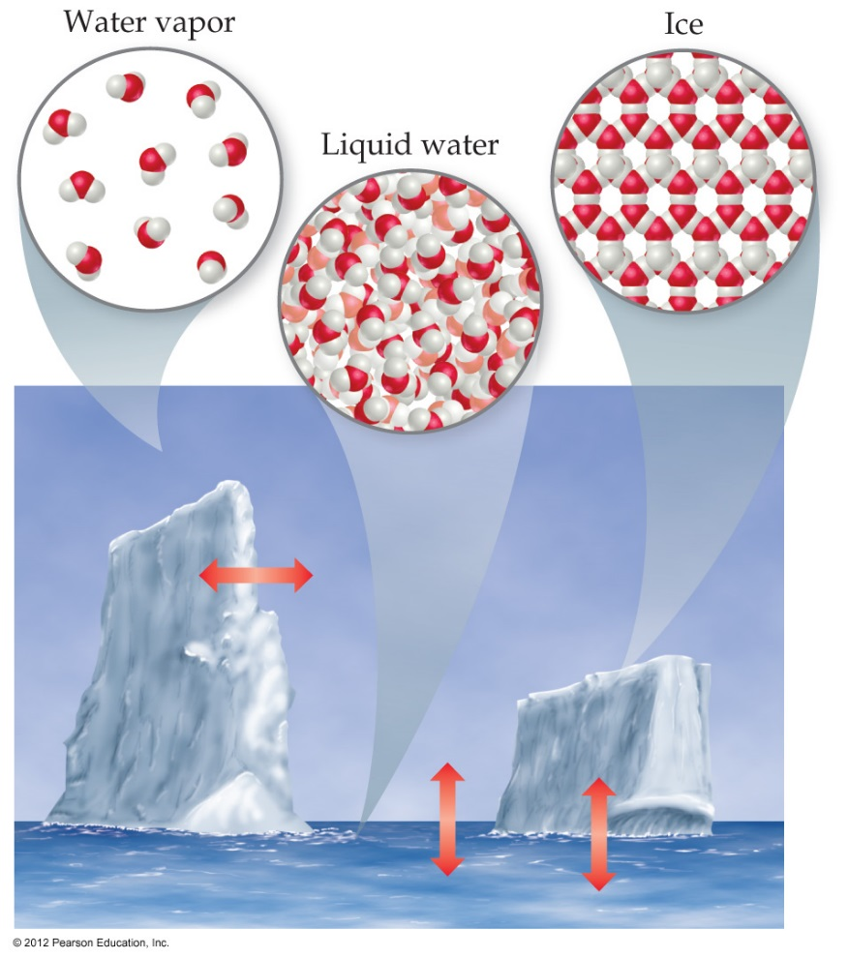
States / Phases of Matter
Solid
Definite volume, definite shape, incompressible
Low atomic motion, very high density
Liquid
Definite volume, indefinite shape, incompressible
Moderate atomic motion, high density
Gas
Indefinite volume, indefinite shape, compressible
High atomic motion, low density

Slide 3
Aristotle’s Chemistry (300 BCE – 1661 )
Aristotle’s four elements correspond to both matter and energy.
In the absence of atomic understanding, it’s not a horrible theory.
States of Matter refer to macroscopic observations so they have been around since Aristotle
Four
Elements
Fire
(Energy)
Earth
(Solid)
Water
(Liquid)
Air
(Gas)
Abandoned in 1661 with the publication of The Skeptical Chemist by Robert Boyle.

Slide 4
Classification of Matter
Besides identifying the state of matter (solid, liquid, gas) we can also classify matter according to its composition
Distinctions to make
Mixtures – Pure substances
Homogeneous – Heterogeneous
Elements – Compounds

Slide 5
Classification of Matter
Pure Substance = a sample of matter with a single uniform chemical composition
Mixture = a sample of matter containing two or more substances, where these substances are not bonded (or joined) to each other and no chemical reaction occurs between the substances.
Component substances (parts of a mixtures)…
are not in a fixed ratio (vary from sample to sample)
keep their individual physical properties
can be separated by mechanical means
Ex: Sand in water

Slide 6
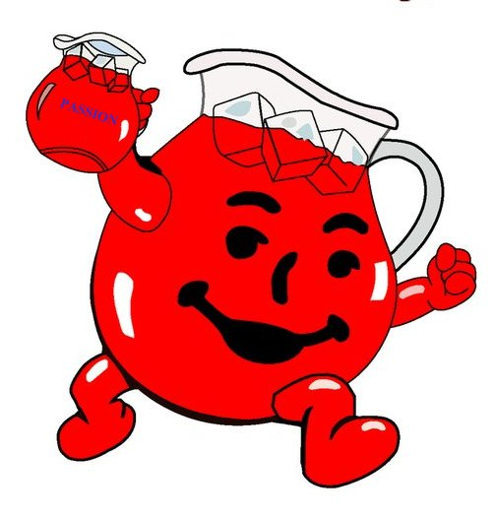
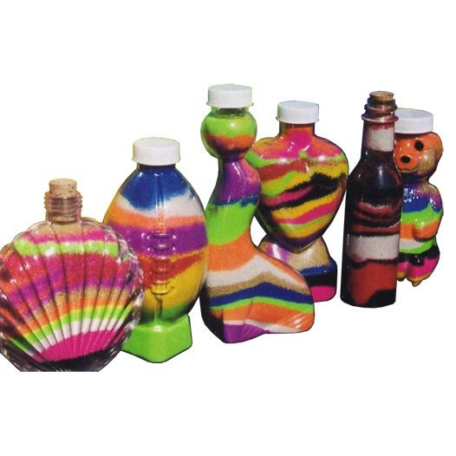
Types of Mixtures
Homogeneous Mixture = a mixture with only one distinct phase (solid, liquid, gas) such that…
Uniform
The different components of the mixture cannot be seen
Heterogeneous Mixture = a mixture with two or more distinct substances and/or phases present
Non-uniform
The different components of the mixture can be seen

Slide 7
Observing mixtures
Clear – means you can see through it (NOT that it looks like water)
Water is both clear and colorless.
It is possible to be clear and red. Ex: Red cellophane, Cherry Koolaid.
Cloudy – means there is a solid present in the liquid.
If a cloudy mixture settles over time, it’s a suspension.
If a cloudy mixture does not settle over time, it’s a colloid.
If a cloudy mixture becomes clear, that means the solid has dissolved and you now have a homogeneous solution.

Slide 8
Common Heterogeneous Mixtures
Phases of matter | Name of mixture | Example
liquid-liquid | emulsion | mayonnaise
solid-liquid | suspension | muddy water
gas-liquid | aerosol | bug spray
gas-solid | smoke | smog

Slide 9
Types of Pure Substances
Mixtures separated by physical means into components are pure substances.
Decompose pure substances using chemical methods: reactivity with other substances, reaction to heat, light or electricity
Element = Pure substance that cannot be broken down into simpler pure substances by any chemical means
Compound = Pure substance that can be broken down into simpler pure substances (other compounds or elements) by chemical means.

Slide 10
Elements
Practice quiz for all 51 Memory elements on 9/27
10 pt quiz for 30 random elements on 9/30
118 known, 91 naturally occurring, 27 synthetic elements
Each element given a one or two letter symbol based on their name in English or Latin (first is capitalized)
Organized on the periodic table
Memorize the symbols for elements with Z ≤ 36 and a few others that are common: Zr, Ag, Sn, Sb, I, Xe, Ba, W, Pt, Au, Hg, Pb, Rn, U, Pu
Remember, the symbol applies to both a single atom and a macroscopic sample of the element

Slide 11
Compounds
Compounds are either crystalline or amorphous (salt/molecule, inorganic/organic)
Law of constant composition / definite proportions
All samples of a given compound contain exactly the same proportion of elements by mass.
Organic Compounds far outnumber Inorganic Compounds even though they only involve a relatively few kinds of elements
Organic compounds typically contain C, H, O, and/or N

Slide 12
Exit Slip - Homework
Exit Slip: None
What’s Due? (Pending assignments to complete.)
Matter Classification Activity if not yet done
Memorize Element Symbols. Practice quiz next time on all 51
What’s Next? (How to prepare for the next day)
Read p4-8

